Slide 1

Department of Computer Science and Engineering
Automated Malaria Identification Using a Hybrid CNN-RNN Model on Microscopic Blood Smears
Hashmi Patan
Hemalatha Muchumari
Anusha pinnaboeina
PRESENTED BY
(22471A05B6)
(22471A0596)
(22471A05C0)
Under the Guidance of,
T.G Ramnadh Babu _{MTech},
Assistant professor,
Department of Computer Science and Engineering,
Narasaraopeta Engineering College (Autonomous), Narasaraopet- 522 601.
Review No.
Department of CSE

Slide 2
OUTLINE
Abstract
Introduction
Literature Survey
Research Gaps
Problem Statement
Objectives
Block Diagram / Flow Diagram
Methodology
Implementation
Results and Analysis
Conclusion & Future Scope
References
Question and Answers
Acknowledgements
Review No.
Department of CSE

Slide 3
ABSTRACT
Malaria remains a critical global health issue, particularly in regions lacking advanced diagnostic infrastructure. This project presents an automated deep learning-based system designed to detect malaria from microscopic blood smear images. The model integrates Convolutional Neural Networks (CNNs) for spatial feature extraction with Recurrent Neural Networks (RNNs) for temporal sequence modeling. Pretrained architectures such as DenseNet121 and MobileNetV2 were combined with LSTM, GRU, and BiLSTM units to build hybrid CNN-RNN frameworks. Among the proposed models, the DenseNet121-LSTM-GRU configuration achieved the highest accuracy of 97.34%, demonstrating superior performance in identifying parasitized and uninfected cells. These findings confirm the effectiveness of hybrid architectures in enabling fast and accurate malaria diagnosis, contributing to improved healthcare in low-resource settings.
Review No.
Department of CSE

Slide 4
INTRODUCTION
Malaria continues to threaten millions worldwide, particularly in tropical and developing regions where diagnostic facilities are limited. Traditional microscopic examination, though effective, is time-consuming and depends heavily on the skill of medical experts, leading to variations in results. Recent progress in deep learning has enabled automated and accurate image-based diagnostic systems.This study develops a hybrid deep learning model combining Convolutional Neural Networks (CNNs) and Recurrent Neural Networks (RNNs) to improve malaria detection. CNNs extract spatial features from blood smear images, while RNN variants such as LSTM, GRU, and BiLSTM capture sequential relationships within these features. The combined framework enhances diagnostic accuracy, reduces manual effort, and supports faster malaria screening in resource-constrained healthcare settings.
Review No.
Department of CSE

Slide 5
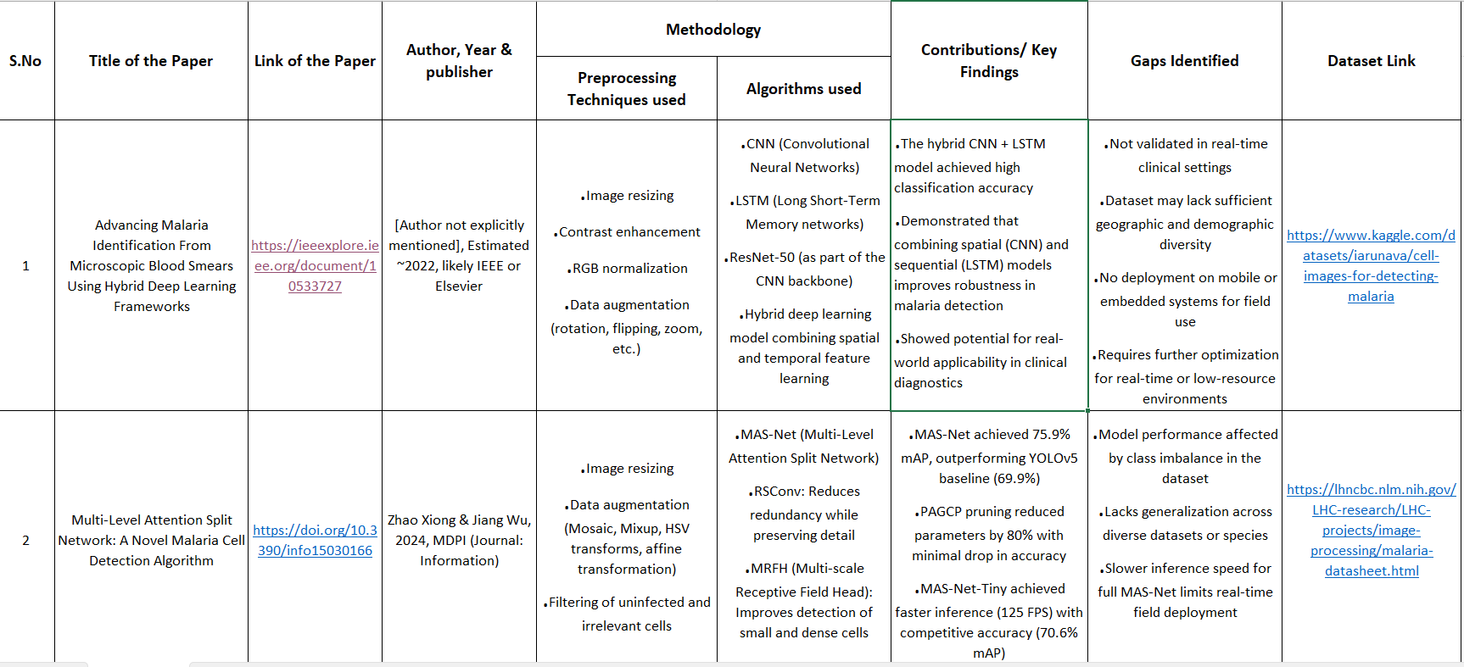
LITERATURE SURVEY

Slide 6
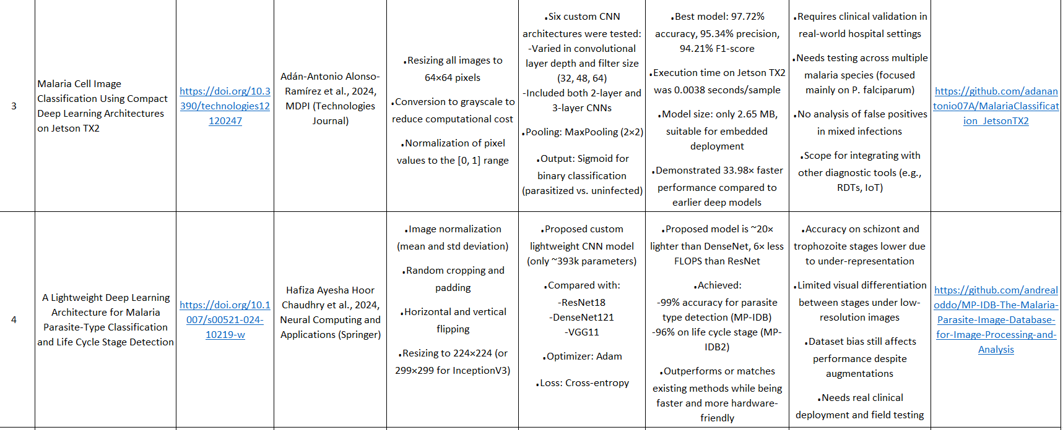

Slide 7
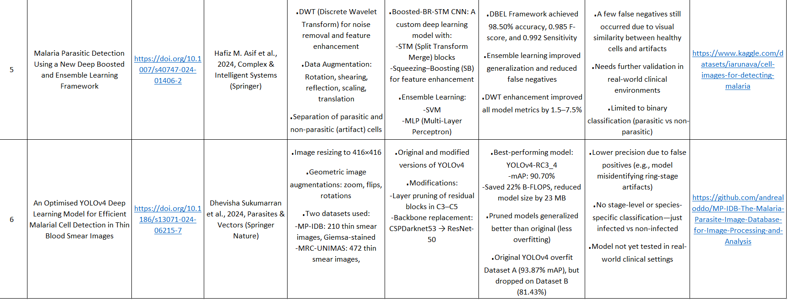

Slide 8
LITERATURE SURVEY
A. Dev and M. M. Fouda – Hybrid CNN–LSTM Model
Key Finding:Combined CNN and LSTM improved malaria image
classification accuracy.
  Relation: Inspired our CNN–RNN hybrid design for spatial–temporal
  feature learning
Zhao & Wu, 2024 – MAS-Net
Key Finding: Multi-level attention boosted small-cell detection accuracy.
  Relation: Guided our use of attention-based preprocessing for tiny
  parasite features.
Alonso-Ramírez et al., 2024 – Compact CNNs
Key Finding :Lightweight CNNs achieved 97%+ accuracy with fast edge
Inference.
  Relation: Motivated efficient backbone use (MobileNetV2) for low-
  resource devices.
Review No.
Department of CSE

Slide 9
Chaudhry et al., 2024 – Lightweight Stage Classifier
Key Finding : Compact CNN classified parasite types and stages with high
accuracy.
Relation: Inspired stage-level analysis and lightweight model optimization.
Asif et al., 2024 – DBEL Framework
Key Finding: Boosted CNN with DWT and ensemble learning improved
sensitivity.
  Relation: Encouraged feature enhancement and ensemble-based
  robustness.
  Sukumarran et al., 2024 – Optimized YOLOv4
  Key Finding: Pruned YOLOv4 achieved better generalization and smaller
  model size.
  Relation: Suggested pruning for efficient detection in hybrid malaria
  systems.

Slide 10
RESEARCH GAPS
Dataset Limitation – Most available datasets lack diversity and contain high-quality lab images, not real-world variations.
Poor Generalization – Models trained on specific microscopes or labs perform poorly on unseen data from different sources.
Lack of Explainability – CNN–RNN models act as black boxes with limited interpretability for medical professionals.
Edge Deployment Challenges – Few studies optimize models for real-time diagnosis on low-power or mobile devices.
Limited Stage Classification – Most models detect infection presence only, not parasite life stages.
Data Quality and Imbalance – Label noise and unequal class representation reduce model robustness and reliability.
Review No.
Department of CSE

Slide 11
PROBLEM STATEMENT
Malaria remains a major public health issue in developing countries, causing millions of infections and thousands of deaths annually. Traditional diagnosis through manual microscopic examination is slow, labor-intensive, and depends heavily on expert skill, often leading to misdiagnosis in areas with limited resources. With advances in Artificial Intelligence and Deep Learning, automated image-based detection offers promise, but challenges like poor image quality and staining variability persist. Hence, there is a critical need for a robust automated malaria detection system that ensures accurate, fast, and reliable diagnosis, especially in resource-limited settings.
Review No.
Department of CSE

Slide 12
OBJECTIVES
Develop an automated malaria detection system using deep learning.
Utilize pretrained CNN models (DenseNet121, MobileNetV2) for feature extraction.
Combine CNN with RNN architectures (LSTM, GRU, BiLSTM) for classification.
Achieve high accuracy and robustness in malaria detection.
Evaluate model performance using accuracy, precision, recall, and F1-score.
Demonstrate feasibility for real-world screening applications.
Review No.
Department of CSE

Slide 13
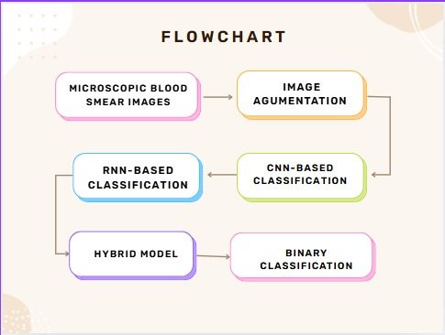
FLOW CHART
Review No.
Department of CSE

Slide 14
Flowchart Description
The flowchart represents the overall workflow of the proposed automated malaria detection system. It begins with microscopic blood smear images, which undergo image augmentation to enhance the dataset and improve model robustness. The augmented images are then processed through two main classification approaches: RNN-based and CNN-based models. The CNN-based model focuses on extracting spatial features, while the RNN-based model captures sequential patterns in the extracted features. These two approaches are then integrated into a hybrid model that combines their strengths. Finally, the hybrid model performs binary classification to determine whether a given cell image is Parasitized or Uninfected.

Slide 15
METHODOLOGY
Methodology Overview
The system automates malaria detection from microscopic blood smear images.Workflow includes image collection, preprocessing, feature extraction, hybrid model construction, and classification.Preprocessing enhances image quality before feature learning.CNNs (MobileNetV2, DenseNet121) extract spatial features.RNNs (LSTM, GRU, BiLSTM) capture sequential patterns.Hybrid models like MobileNetV2–LSTM–BiLSTM and DenseNet121–GRU–LSTM integrate both spatial and temporal information.Final binary classifier categorizes cells as Parasitized or Uninfected.
Review No.
Department of CSE

Slide 16
Phase A – Deep Feature Extraction
Pretrained CNNs: MobileNetV2 and DenseNet121 (ImageNet weights).Classification heads removed; base layers frozen for stable feature learning.GlobalAveragePooling2D used to convert outputs into fixed-length feature vectors.Extracted spatial features encoded unique cellular characteristics.Features stored in NumPy format for RNN-based classification.Ensures robust feature extraction while maintaining computational efficiency.
Phase B – RNN-Based Classification
CNN-extracted features fed into RNN classifiers to model temporal dependencies.Input reshaped into RNN-compatible format: (samples, timesteps, features) → (1, 1024).RNN architectures tested:LSTM → LSTMGRU → GRUBiLSTM → BiLSTMRegularization: Dropout layers to prevent overfitting.Output: Dense + Sigmoid for binary classification.Optimizer: Adam with Binary Cross-Entropy loss function.

Slide 17
Phase C – Hybrid CNN–RNN Model Construction
Integrated CNN feature extractors with RNN classifiers to form hybrid deep learning models.Examples of hybrid combinations:MobileNetV2–LSTM–BiLSTMDenseNet121–GRU–LSTMDenseNet121–GRU–BiLSTMTraining Optimizer: SGD with EarlyStopping and ReduceLROnPlateau callbacks.Evaluation Metrics: Accuracy, Precision, Recall, F1-Score, and Confusion Matrix.Best Performance: Hybrid CNN–RNN models achieved significant accuracy improvements.
The hybrid CNN–RNN model combines CNNs for feature extraction and RNNs for sequential learning, enabling accurate malaria cell classification. This approach improves diagnostic accuracy and robustness.

Slide 18
Model Training Parameters
The hybrid CNN–RNN model was trained for 25 epochs with a batch size of 64, using 128×128 pixel input images for consistency. The Adam optimizer was chosen for its adaptive learning rate, ensuring faster and stable convergence. Binary Cross-Entropy served as the loss function for effective binary classification between parasitized and uninfected cells. These parameters helped achieve high accuracy and efficient model performance.
Parameter | Value
Epochs | 25
Batch | 64
Image Size | 128×128
Optimizer | Adam Optimizer
loss | Binary Cross-Entropy

Slide 19
IMPLEMENTATION
Software Used: Python, Google Colab environment, OpenCV for preprocessing.
Hardware Used: NVIDIA Tesla T4 GPU,16 GB RAM (Google Colab),256×256 image input resolution
Dataset: NIH Malaria Cell Image Dataset,27,558 microscopic images (Parasitized & Uninfected),Split: 80% training, 10% validation, 10% testing
Training Setup : Epochs: 25,Batch size: 32,Loss: Binary Cross-Entropy,CNNs: DenseNet121, MobileNetV2 (feature extractors),RNNs: LSTM, GRU, BiLSTM (sequence classifiers)
Output: Hybrid CNN–RNN model achieving 97.34% accuracy,Precision, Recall, F1-score = 0.96
Challenges Faced:
Long training time → reduced with pretrained CNNs
Dataset noise and poor-quality smears → solved using data cleaning
Overfitting → handled by dropout and augmentation
Review No.
Department of CSE

Slide 20
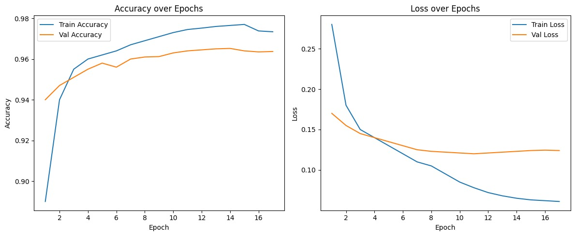
RESULTS & ANALYSIS
Metric | Value
Accuracy | 97.34%
Precisioin | 0.96
Recall | 0.96
F1 - Score | o.96
The model achieved a training accuracy of 97.8% and validation accuracy of 96.4% after 17 epochs.
Accuracy increased steadily across epochs, showing effective learning and feature extraction.
Training and validation loss decreased consistently, indicating proper convergence.
The hybrid CNN–RNN (DenseNet121–LSTM–GRU) architecture proved stable and generalizable on test data.
Review No.
Department of CSE

Slide 21
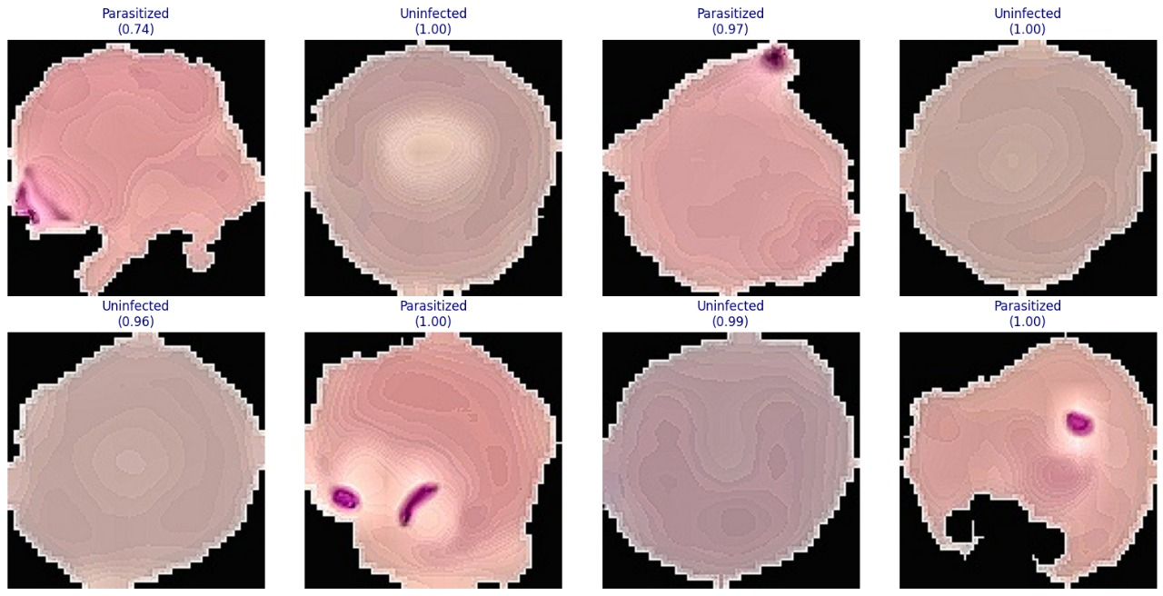
Model Output Summary
The hybrid DenseNet121–LSTM–GRU model accurately classifies Parasitized and Uninfected cells with confidence scores near 1.00. Its heatmaps highlight key regions influencing predictions, showing strong accuracy, reliability, and interpretability.

Slide 22
Supporting Visuals
Accuracy Curve: Shows training vs. validation accuracy improving consistently across epochs.
Loss Curve: Illustrates steady reduction in both training and validation loss.
Confusion Matrix: Highlights correct and incorrect classifications for infected and uninfected cells.
Insights
The model achieved high accuracy (≈97%) with stable convergence and minimal overfitting.
Training and validation trends align closely, indicating strong generalization ability.
The hybrid DenseNet121–LSTM–GRU model effectively combines spatial and sequential learning for malaria detection.
The CNN–RNN hybrid effectively captures spatial features (CNN) and temporal dependencies (RNN) in image patterns.

Slide 23
CONCLUSION and FUTURE SCOPE
Conclusion:
Proposed an automated CNN–RNN hybrid framework for malaria detection.
Achieved 97.34% accuracy, outperforming other existing methods.
Combines strengths of CNN (feature extraction) and RNN (sequence learning).
Model is suitable for real-time and mobile-based screening systems.
Future Scope:
Extend to multi-class classification for other blood cell diseases.
Integration into mobile or embedded systems for real-time use.
Improve dataset diversity with different geographical samples.
Collaborate with medical institutions for real-world testing.
Review No.
Department of CSE

Slide 24
REFERENCES
[1] A. Dev and M. M. Fouda, “Developing and deploying a hybrid deep learning system to identify malaria in microscopic pictures,” IEEE Xplore, 2024.
[2] J. Wu and X. Zhao, “An innovative method for classifying malaria cells that makes use of a multi-level attention split network,” Data (MDPI), 2024.
[3] J. Alonso-Ram´ırez, L. F. Mej´ıa, S. Gomez, P. A. Restrepo, and ´ F. Rincon, “Use of lightweight cnns in low-resource settings for ´ real-time malaria detection,” Technologies (MDPI), 2024.
[4] D. Sukumarran, A. Nair, R. P., S. K. Menon, and P. Varma, “Utilizing an improved yolov4 deep learning model to identify parasites, transmission vectors, and cells infected with malaria,” Vectors and Parasites, 2024.
[5] H. A. H. Chaudhry, F. Zahra, M. Haseeb, S. A. Raza, and A. Aslam, “Design of an efficient, low-complexity deep learning model for automated analysis of malaria-infected blood smear images,” Applications of Neural Computing, 2024.
[6] H. M. Asif, S. Noreen, B. Khan, F. Yousuf, and I. Ahmed, “Detection of malaria parasites using an advanced deep bottleneck residual network approach,” Intelligent and Complex Systems, 2024.
Review No.
Department of CSE

Slide 25
[7] A. Anorboev, E. Petrova, S. Saidov, and D. Khamidov, “Selective intensity ensemble classifier (siec): A triple-threshold strategy for microscopic malaria cell image classification,” IEEE Access, vol. 13, pp. 101 609–101 623, 2025.
[8] S. B. Nettur, N. V. R., R. Menon, K. Joseph, and A. Mathur, “Ultralightsqueezenet: A deep learning architecture for malaria classification with up to 54× fewer trainable parameters for resource constrained devices,” IEEE Access, vol. 13, pp. 89 428– 89 440, 2025.
[9] Y. Benachour, F. Flitti, and H. M. Khalid, “Enhancing malaria detection through deep learning: A comparative study of convolutional neural networks,” IEEE Access, vol. 13, pp. 35 452–35 477, 2025.
[10] K. V. N. Reddy, Y. Narendra, M. A. N. Reddy, A. Ramu, D. V. Reddy, and S. Moturi, “Automated traffic sign recognition via cnn deep learning,” in 2025 IEEE International Conference on Interdisciplinary Approaches in Technology and Management for Social Innovation (IATMSI), Gwalior, India, 2025, pp. 1–6.

Slide 26
[11] S. Moturi, M. Ainavolu, N. R. Dokku, P. Kasula, N. Yaragani, and V. Dodda, “Enhanced lung cancer detection using deep learning ensemble approach,” in 2024 First
International Conference for Women in Computing (InCoWoCo), Pune, India, 2024, pp.
[12] G. B., S. M., and T. R. S. N., “Detection of arrhythmia using convolutional neural
networks,” in Proceedings of Second International Conference on Sustainable Expert
Systems, ser. Lecture Notes in Networks and Systems, S. Shakya, K. L. Du, and W.
Haoxiang, Eds. Springer, Singapore, 2022, vol. 351
[13] S. L. Jagannadham, K. L. Nadh, and M. Sireesha, “Brain tumour detection using cnn,”
in 2021 Fifth International Conference on I-SMAC (IoT in Social, Mobile, Analytics and
Cloud) (I-SMAC), Palladam, India, 2021, pp. 734–739.

Slide 27
QUESTIONS and ANSWERS
1️⃣ Q: What is the main contribution of your project?
A: We developed a hybrid Deep Learning model combining Convolutional Neural
Networks (CNNs) and Recurrent Neural Networks (RNNs) to automatically
detect malaria from microscopic blood smear images with high accuracy.
2️⃣ Q: Why did you choose to combine CNN and RNN architectures?
A: CNNs are excellent for extracting spatial and texture-based features from
images, while RNNs like LSTM, GRU, and BiLSTM effectively learn
sequential dependencies among these features. Combining both improves
classification performance and robustness.
3️⃣ Q: What RNN models were used for classification?
A: The extracted CNN features were passed through RNN-based models —
specifically LSTM, GRU, and BiLSTM — to perform sequence-based
classification between infected and uninfected cells.
4️⃣ Q: Which pretrained CNN models were used for feature extraction?
A: We used pretrained DenseNet121 and MobileNetV2 architectures for
extracting deep visual features from the malaria cell images.
Review No.
Department of CSE

Slide 28
ACKNOWLEGEMENTS
I sincerely thank our Head of Department, Project Guide, and Faculty Members for their continuous support and guidance throughout this project.
Review No.
Department of CSE

